Slide 1
Room1
Tree
Room 2
Room 3
Track Layout Plan
Table 1
Table 2
Kitchen Counter

Slide 2
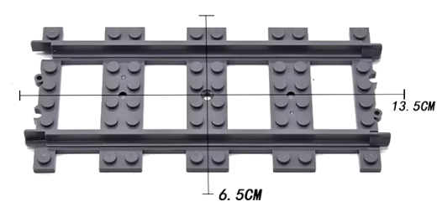
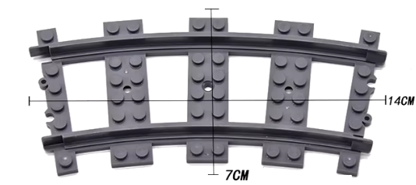
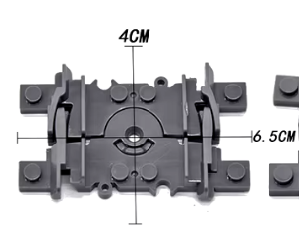
Bestand
2023 | 2024
40 aka. 5,20 | 120
30 aka. | 50
0 | 30

Slide 4
31 x Straight
20 x Curve
48 x Straight
12 x Curve
22 x Straight
14 x Curve
Total:
101 x Straight
´46 x Curve

Slide 6
Einkaufen
4x MDF 50 x 50cm
2x Brett 100mm x 2000mm (Glattkantbrett Douglasie 18 x 100 x 2500 mm 6 €)
3x Latte 2m
Winkel 10 stk
Mini Schrauben 100 stk

Slide 7
Room 1
Tree
Room 2
Room 3
Track Layout Plan
2023
Table 1
Table 2
Kitchen Counter

Slide 8
Room1
Tree
Room 2
Room 3
Track Layout Plan
2024
Table 1
Table 2
Kitchen Counter

Slide 9
Room1
Tree
Room 2
Room 3
Table 2
Table 1
Kitchen Counter

Slide 10
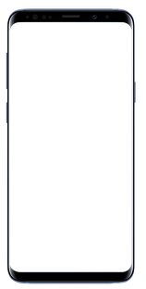
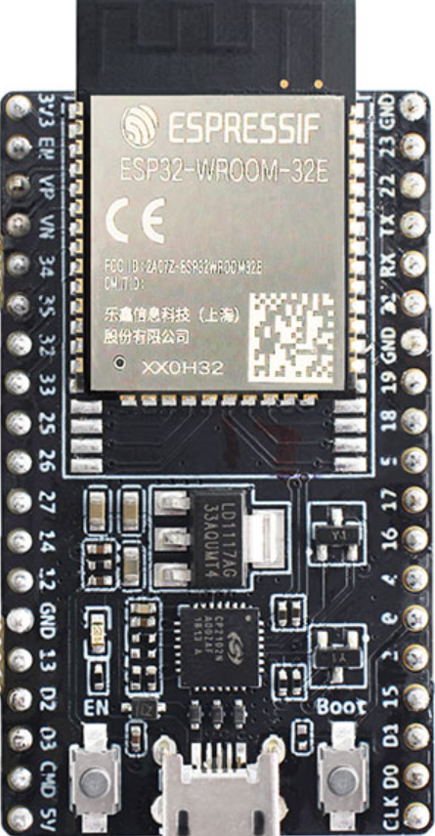
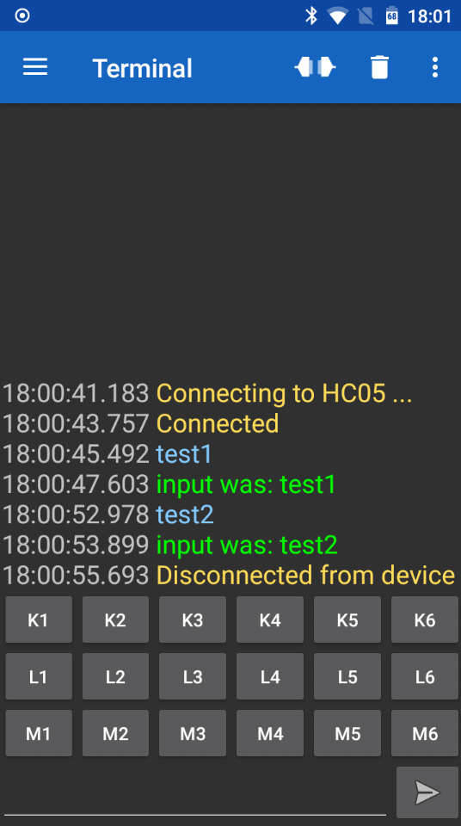

Communication Diagram
Control Device
Protocol
Controller
Devices
channel message
input channel
Button
[ JSON message ]
[ digital input ]
channel settings
[ JSON message ]
data
[ JSON message ]
output channel
Motor
[ via Bluetooth UART ]
[ ESP 32 ]
[ 2 PWM Pins ]
[ Smartphone with Bluetooth Serial App ]

Slide 11
Communication Diagram (simplified)
Control Device
Controller
Devices
Protocol
input
Button
channel message
[ digital input ]
[ JSON message ]
[ via Bluetooth UART ]
output channel
Motor
[ ESP 32 ]
[ 2 PWM Pins ]
[ Smartphone with Bluetooth Serial App ]

Slide 12
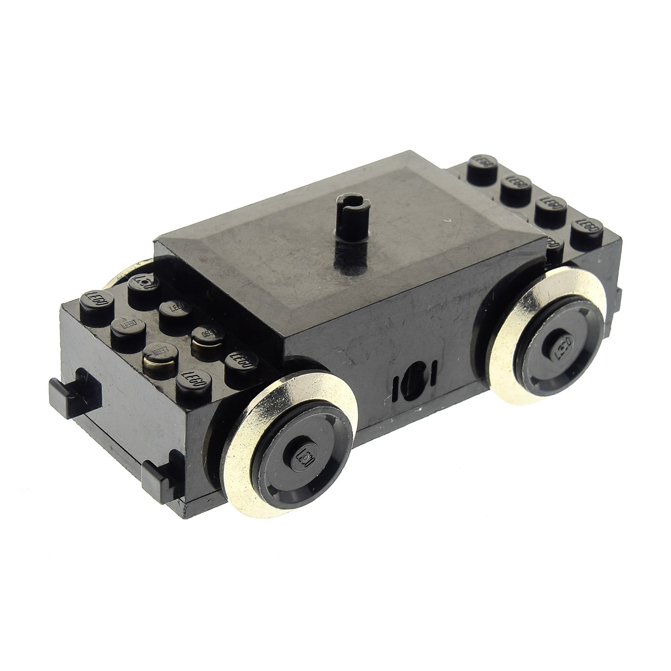
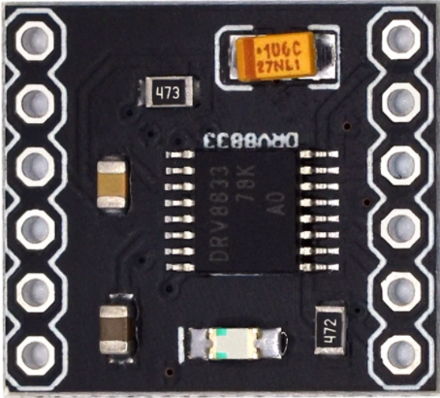
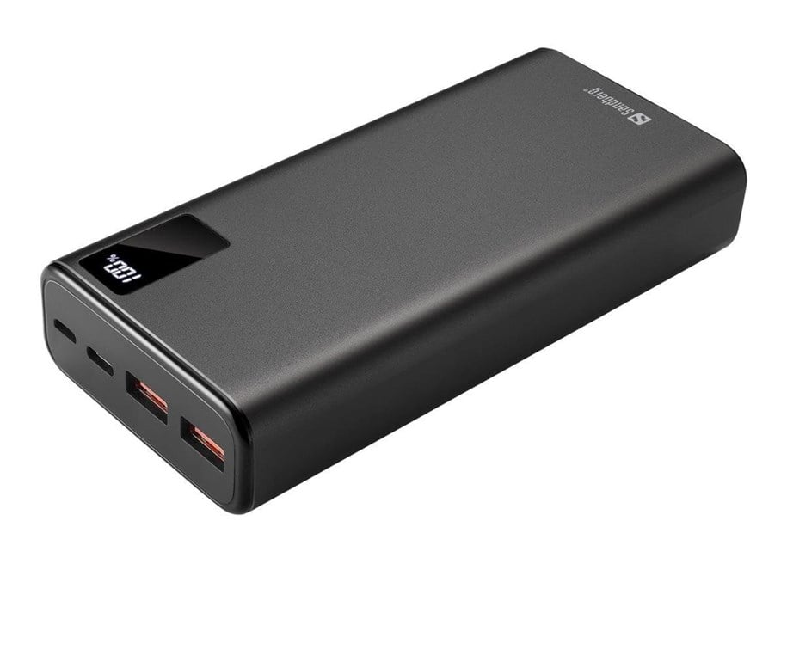
Motor Driver
[ DRV8833 ]
Motor
[ 9 V LEGO Motor ]
Controller
[ ESP32 ]
Power Source
[ Power Bank ]

Slide 13
Communication Diagram (Examples)
Control Device
Controller
Devices
Protocol
input
Button
channel message
[ digital input ]
[ JSON message ]
[ via Bluetooth UART ]
output channel
Motor
[ ESP 32 ]
[ 2 PWM Pins ]
[ Smartphone with Bluetooth Serial App ]

Slide 14
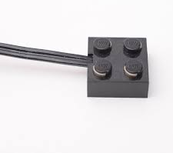
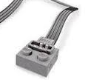
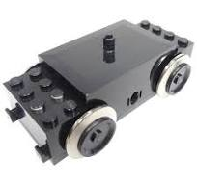
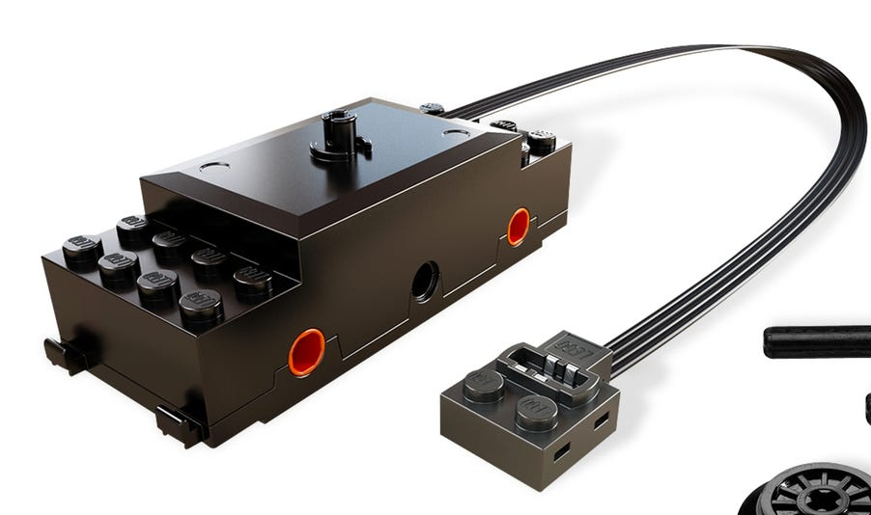
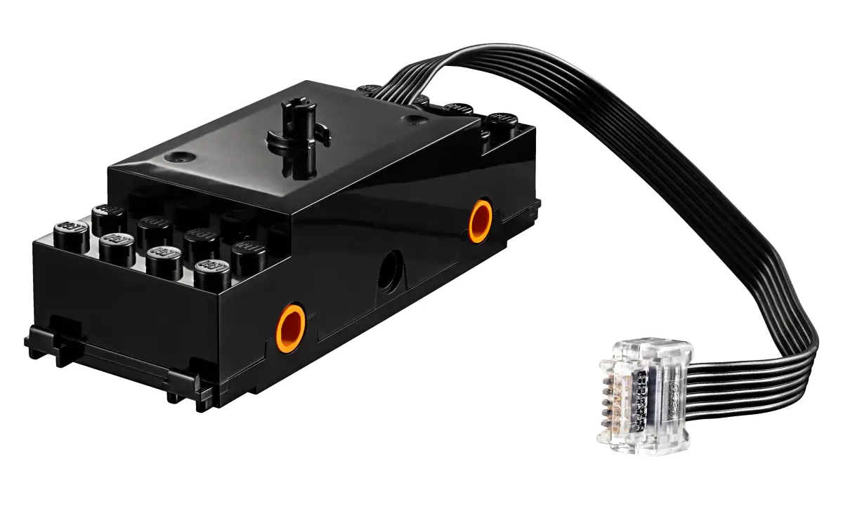
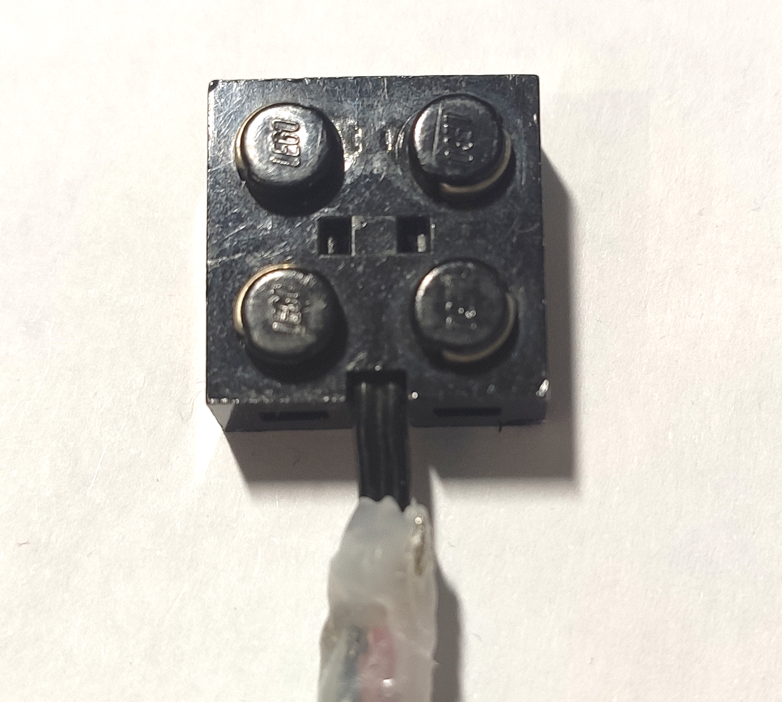
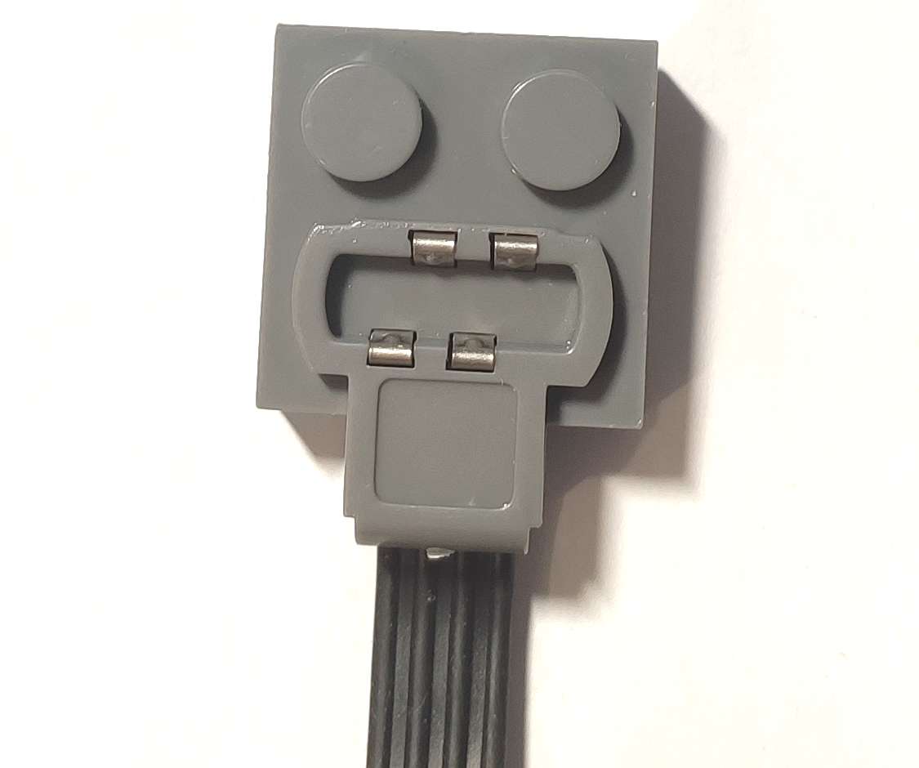
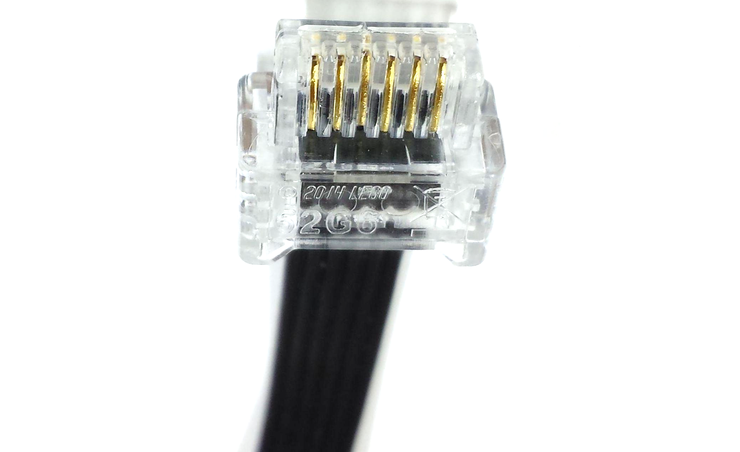
Train Motor | Classic 9 V | Power Functions | Powered Up
Image
Connector Pinout
Production Time | 1991-2008 | 2007-2020 | 2016 - today
LEGO Part Number | 5300 | 88002 | 88011
Voltage | 9V | 6 – 9 V (6 AA batteries) | 6 – 9 V (6 AA batteries)
Current (avg) | 0,38 A | 0,41 A | ?
Current (max) | 0,95 | 1,30 A | ?
GND
9V
C1
VCC
GND
VCC
M2
ID1
GND
C2
M1
ID2
GND
9 V
GND
9 V
GND
VCC
C1
C2

Slide 15
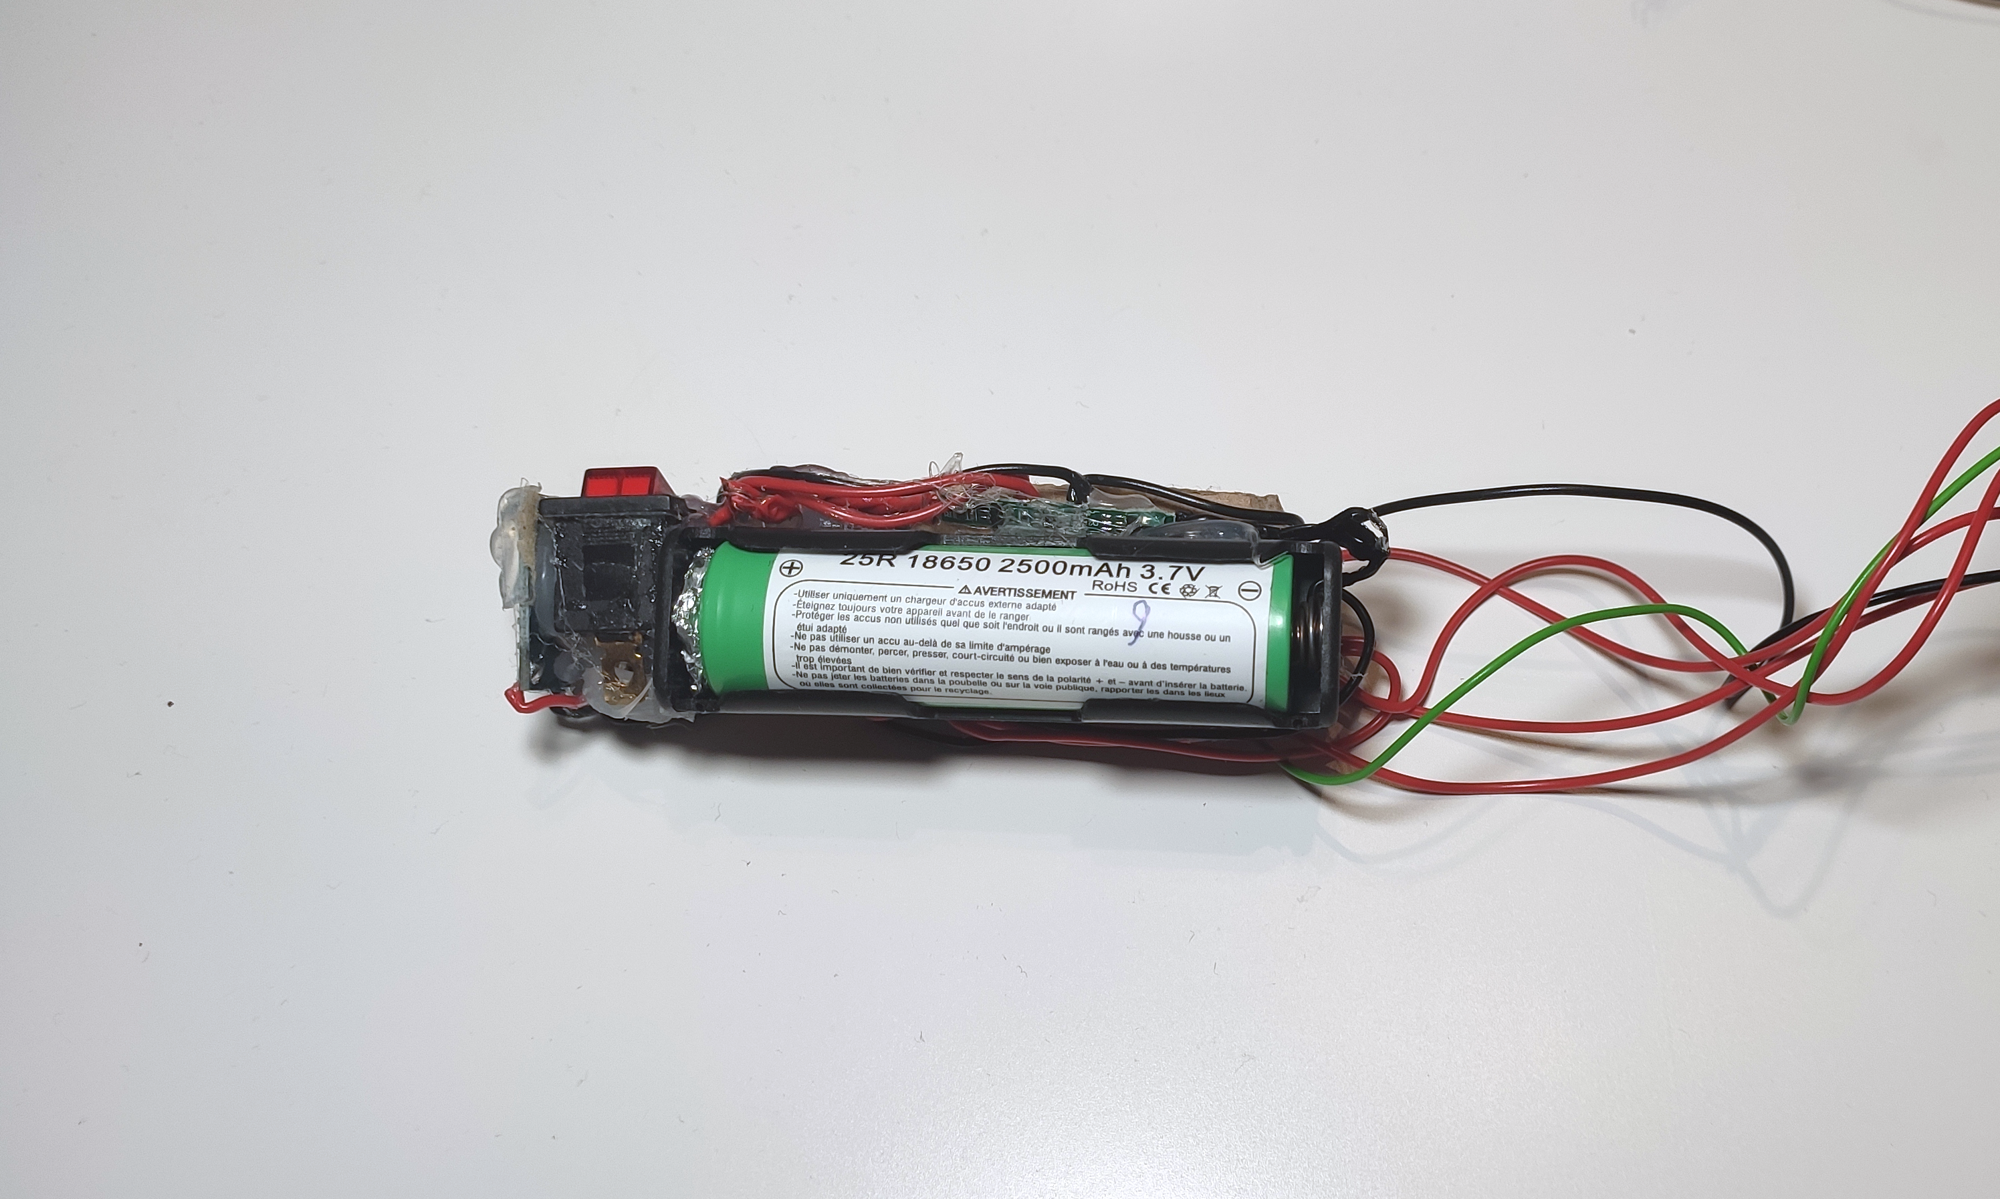
My Sketchy Little Power Supply
( Battery Section )
Battery Management System Module
Charging Module
18650 Li-Ion Battery

Slide 16
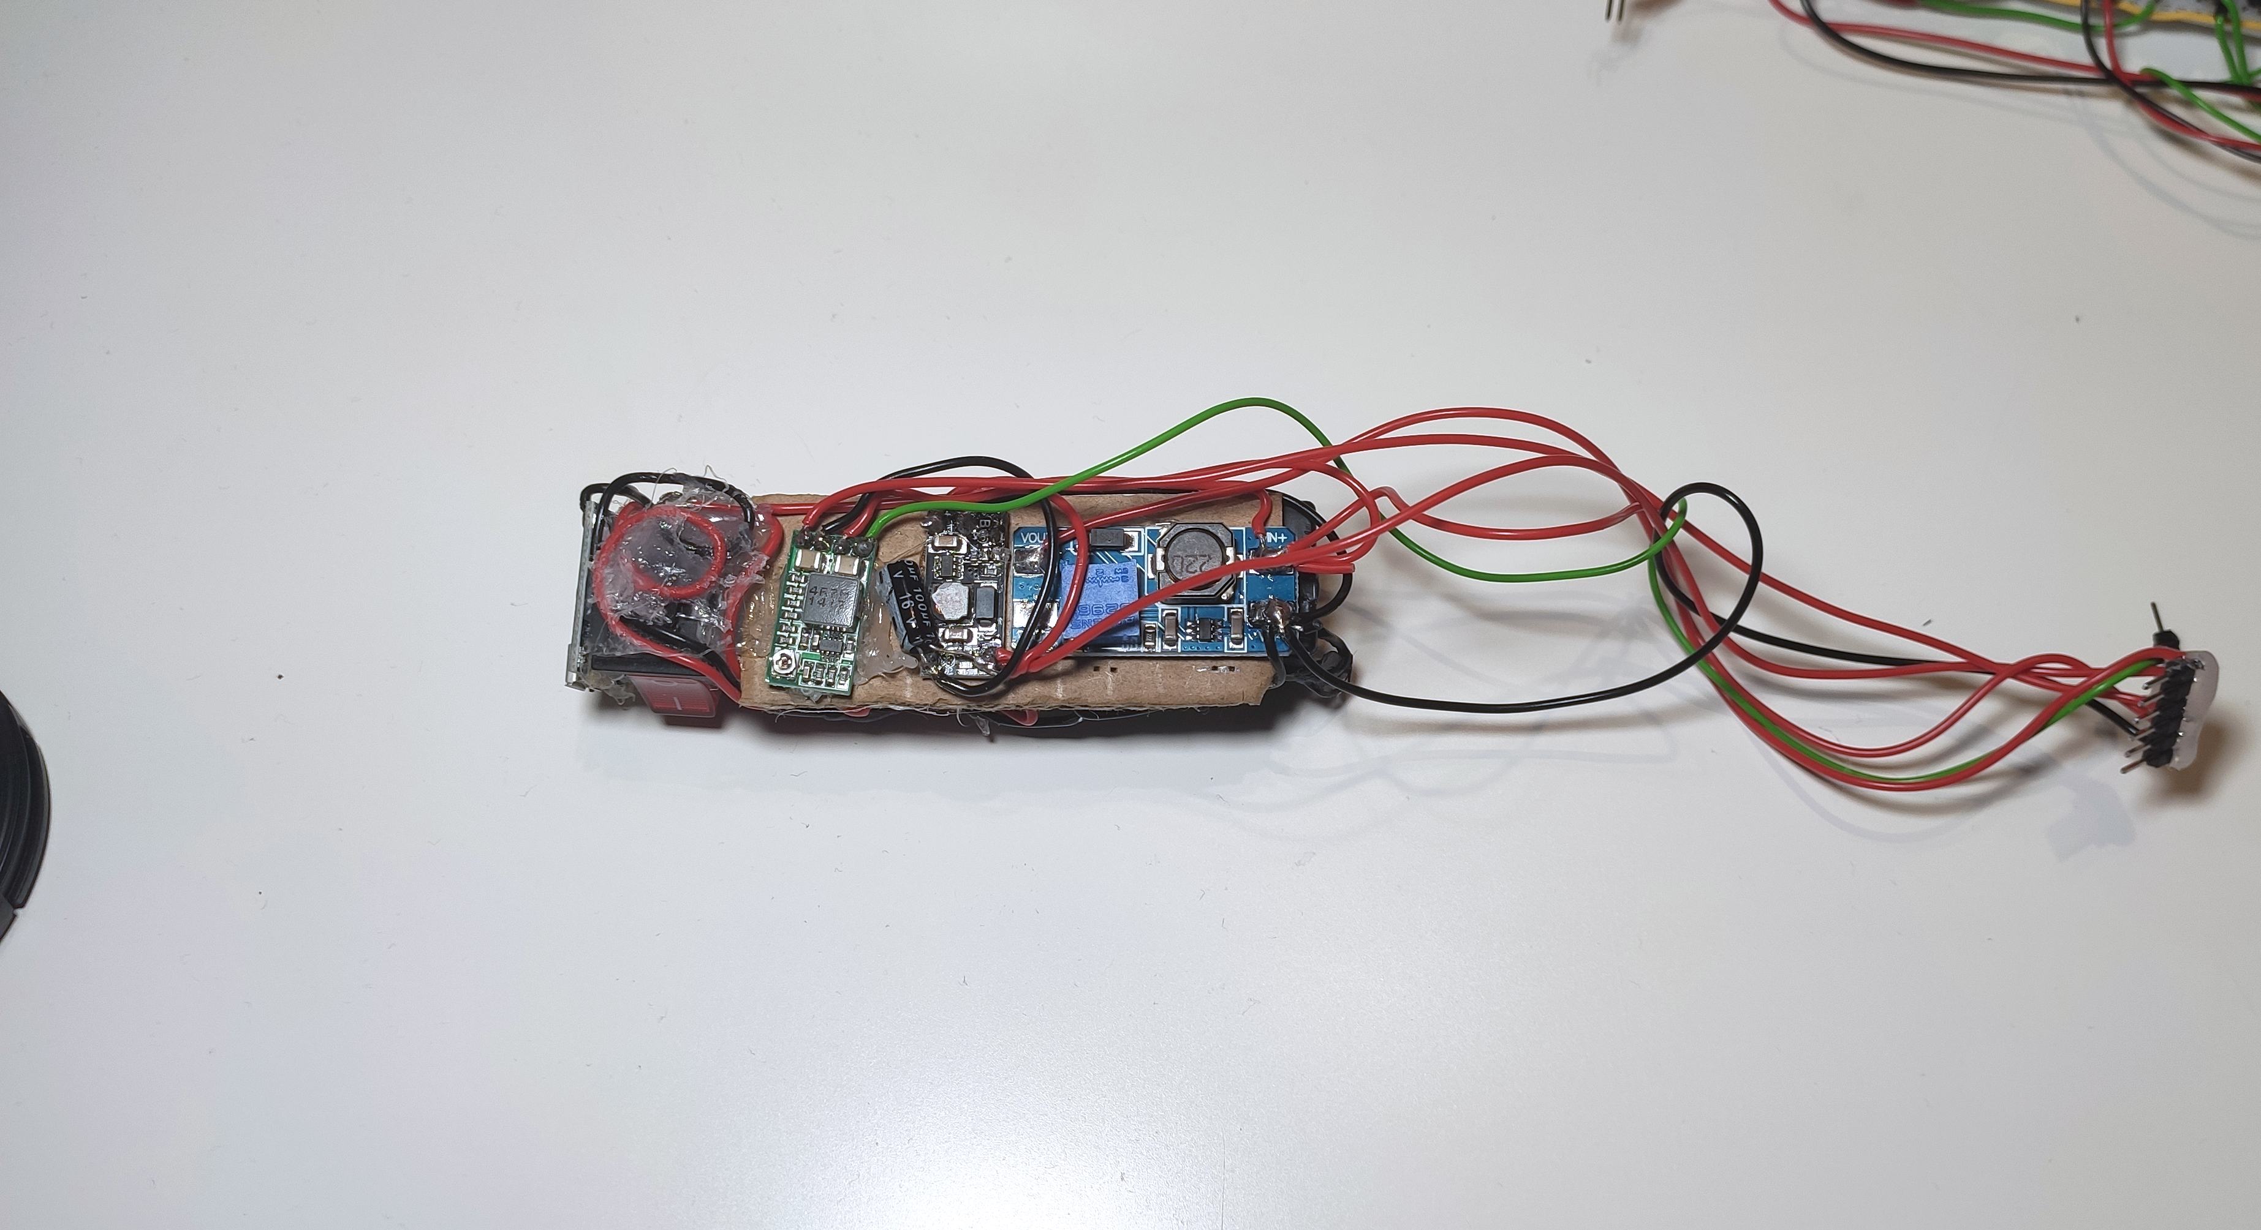
My Sketchy Little Power Supply
( Voltage Conversion Section )
2.8 V
to string lights
Power Switch
5 V
to controller
2.8 – 4.2 V
from battery
9 V
to motor
Buck Converter
Boost Converter 2
Boost Converter 1

Slide 17

Thanks For Watching
Documentation
can be found on Instructables
Link Below

Slide 18
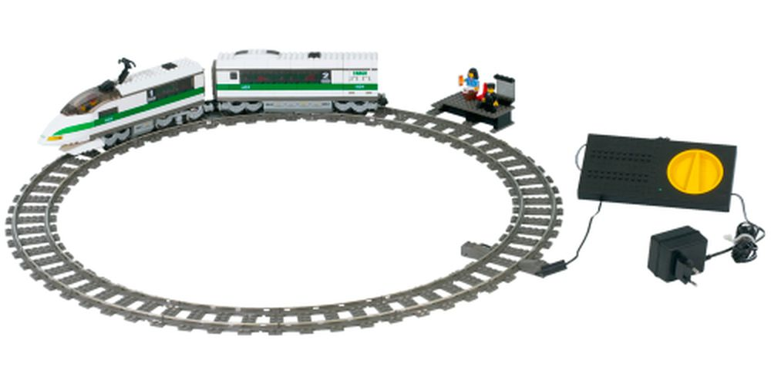
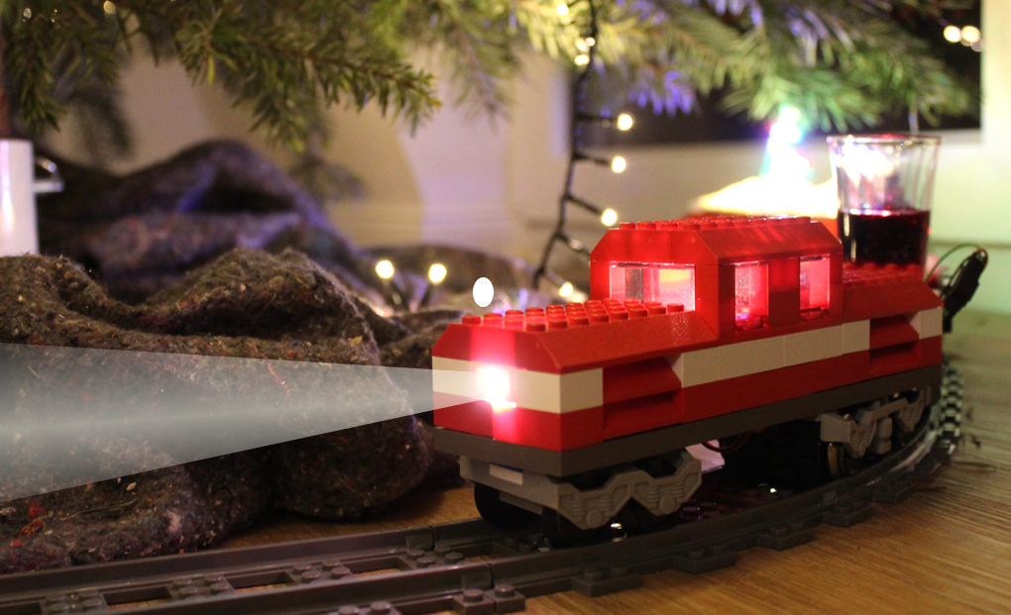
Project History
2021
V1
2022
2005
V2
2023
V0
V3

Slide 19
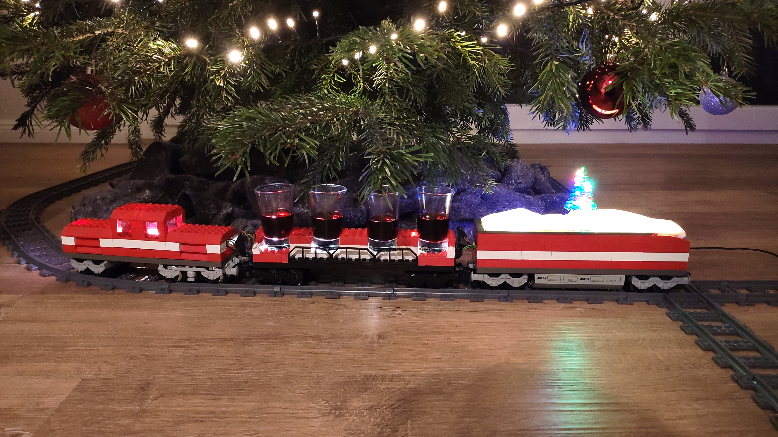
Connection Points 1 & 2
RGB LEDs (3 Pin)
Motor Dirver (4 Pin)
Locomotive
RGB LEDs
Motor Driver
Drink Carriage
RGB LEDs
Electronics Carriage
Controller
Sensor
Christmas Lights
Power Supply

Slide 20
Connection Points 1 & 2
RGB LEDs (3 Pin)
I2C
Battery Power
Connection Points 1 & 2
RGB LEDs (3 Pin)
I2C
Locomotive
Normal LEDs
Motor Driver
2x Motor
Control Electronics
NFC Sensor
Battery Carriage
Battery
BMS
Switch
Inductive Charging
Encoder
Christmas Carriage
Christmas Lights
DC-DC
I2C Output Control
RGB LEDs
Drink Carriage
RGB LEDs

Slide 21
Connectors on the train
External
Internal
Motor Driver Connector
Pin | Description
1 | GND
2 | In 1
3 | In 2
4 | 9 V
Sensor Connector
Pin | Description
1 | GND
2 | I/O
3 | 3.3 V
Power Supply Connector
Pin | Decription
1 | GND
2 | VBat
3 | 2.8 V
4 | 3.3 V (Not Connected)
5 | 5 V
6 | 9 V
RGB LED Connector | RGB LED Connector
Pin | Description
1 | GND
2 | DIN
3 | 5 V
String Lights Connector
Pin | Description
1 | GND
2 | 2.8 V

Slide 23
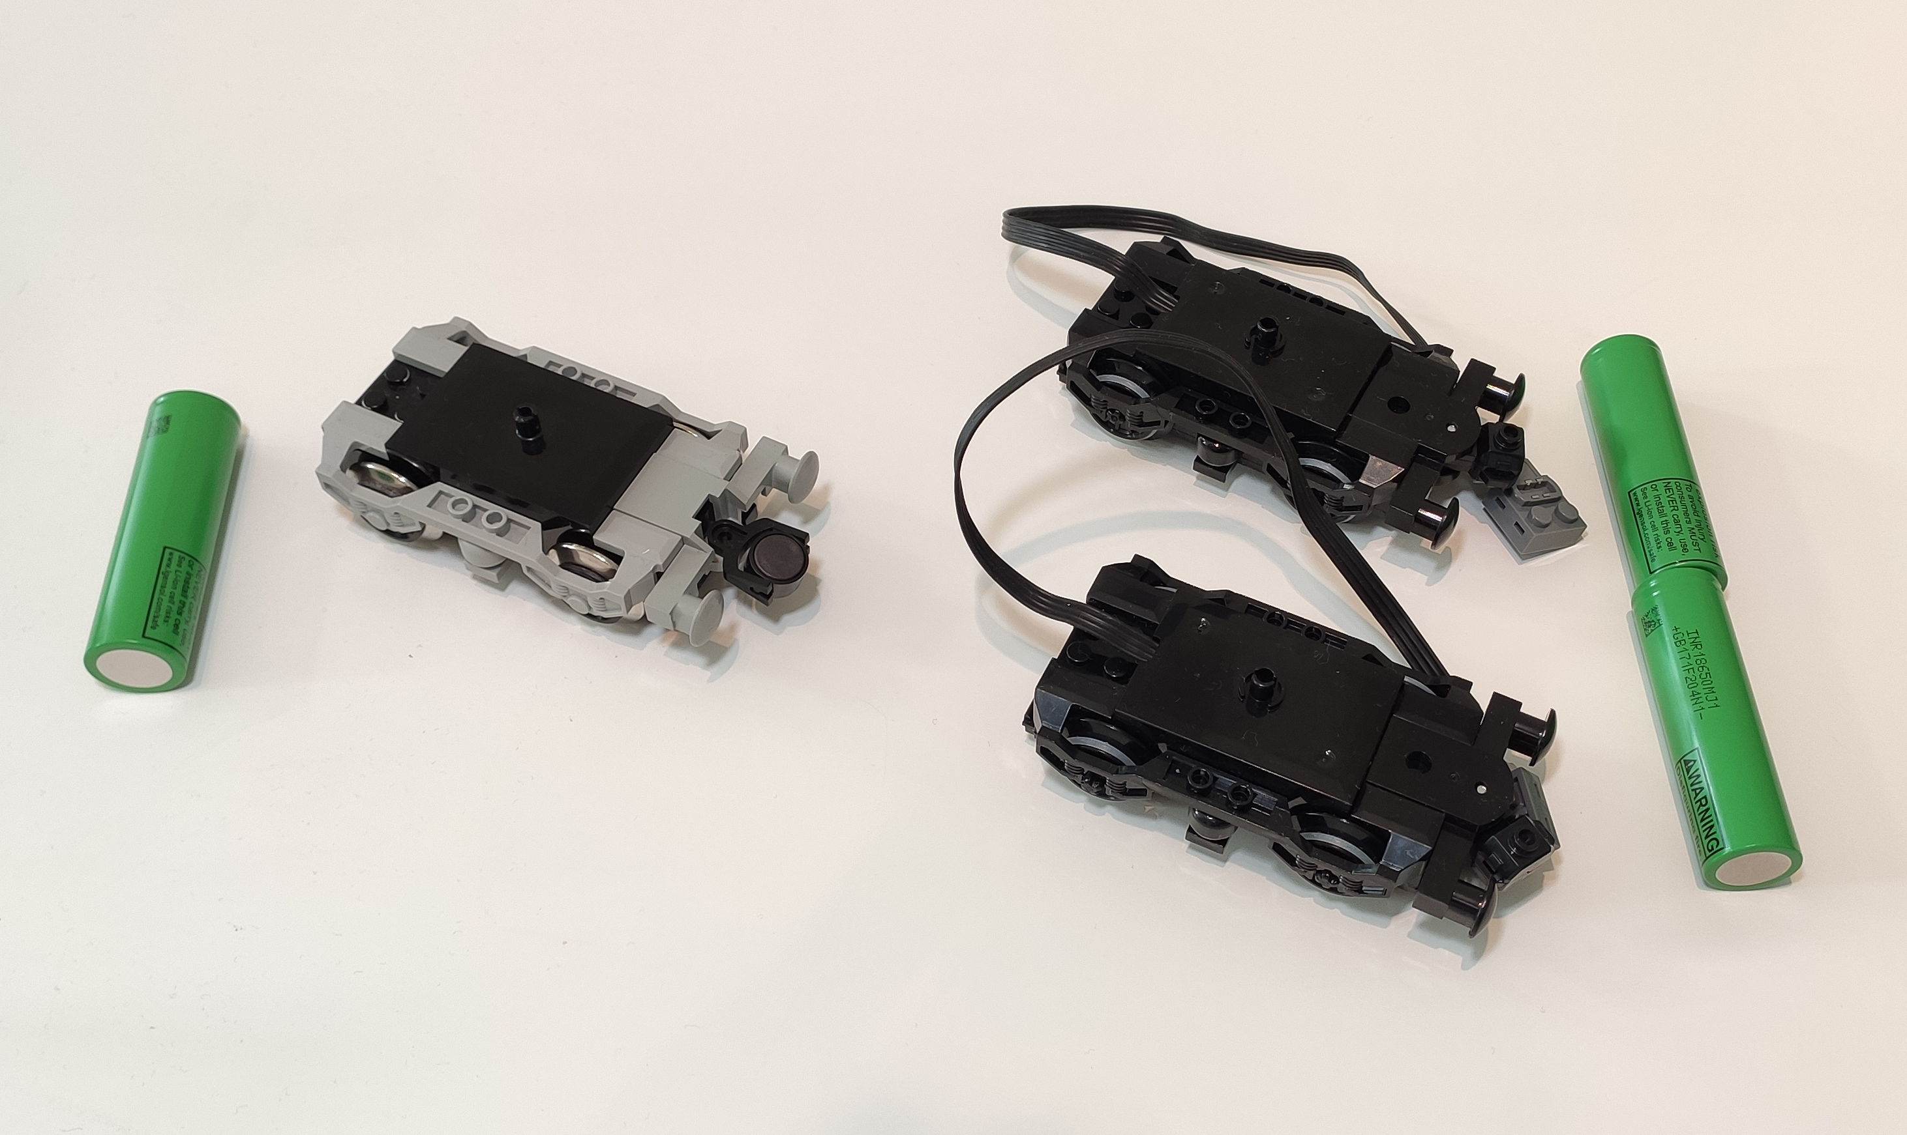
Current Setup
Future Setup
1 S battery
2 S battery
Single 9 V Motor
2x Power Functions Motors

